Slide 1
Project Management and Agile Methodologies

Slide 2
Project Management
Project Management is not just a PLAN but determines….
Scope
Time
Cost
Quality
Risks
Communication
Stakeholder
Resources
Procurement
Integration

Slide 3
Classic Project Management Approach Micro Management Modern Project Management Approach Triple M (Modern Mind Management)

Slide 4
Waterfall Methodology

Slide 5
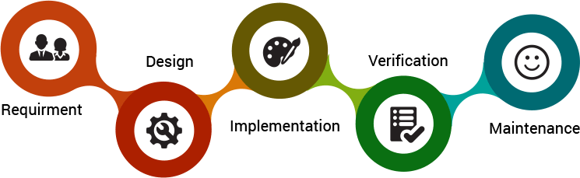

Slide 6
Agile Methodologies
SCRUM
Lean Software Development Kanban Extreme Programming (XP) Crystal Dynamic Systems Development Method (DSDM) Feature Driven Development (FDD) TDD CI/CD

Slide 7
What is Scrum?
A framework within which people can address complex adaptive problems, while productively and creatively delivering products of the highest possible value. Scrum Values: Courage, Commitment, Focus, Openness, and Respect
Our main focus is on:
Transparency Inspection
Adaptation

Slide 8
How we use Scrum
Roles that we have:
Scrum Master
Product Owner
Development Team

Slide 9
Scrum Events:
Sprint Planning
The Sprint
Daily Scrum
Sprint Review
Sprint Retrospective

Slide 10
Product Backlog

Slide 11
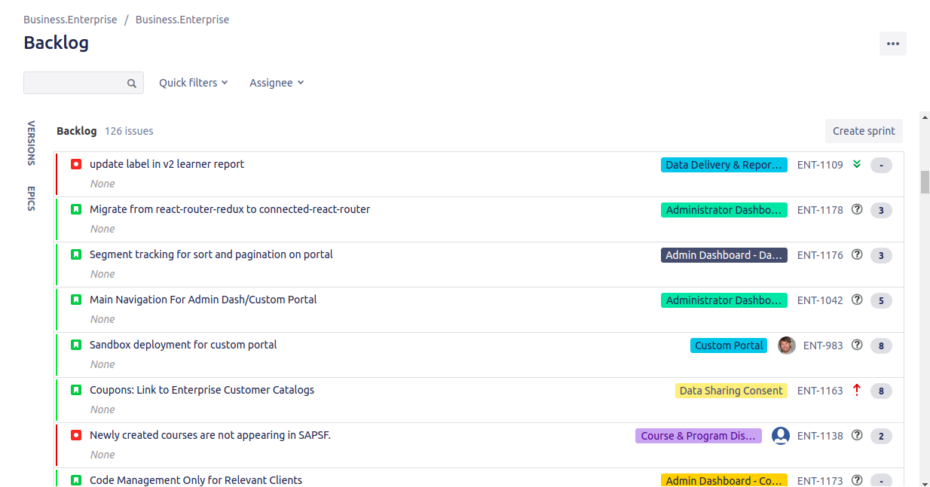

Slide 12
Sprint Planning
Also known as Backlog Grooming

Slide 13
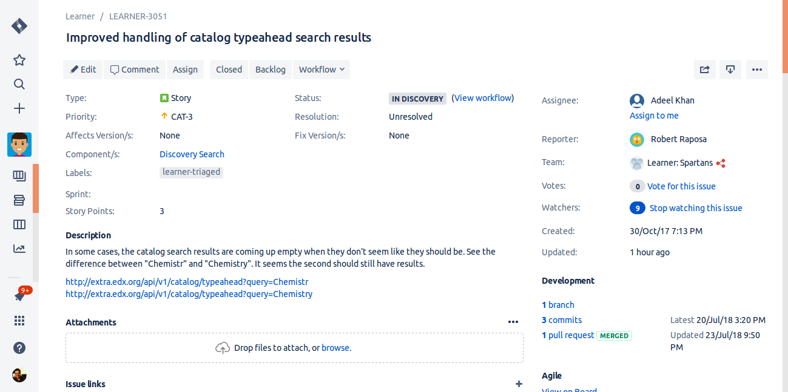

Slide 14
The Sprint

Slide 15
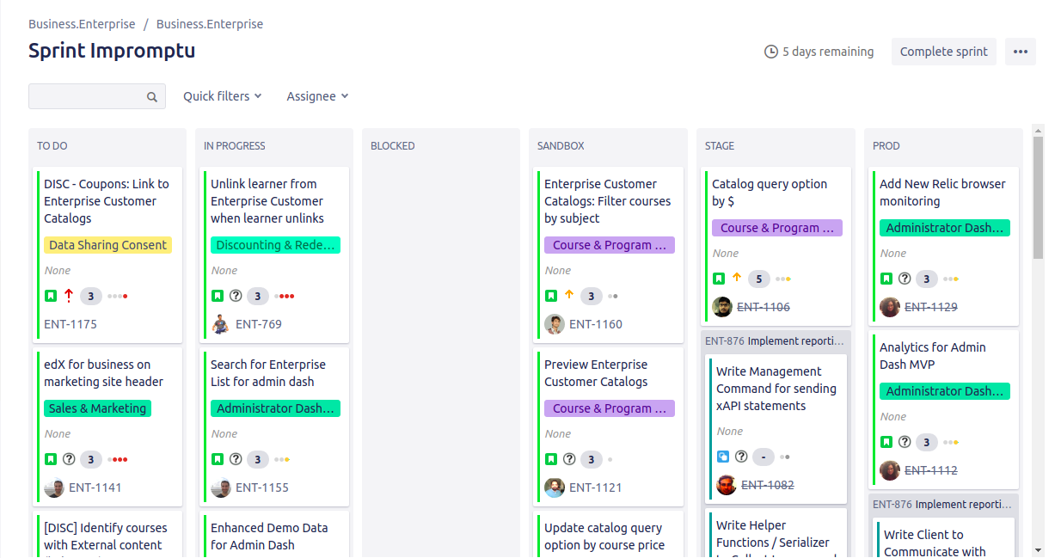

Slide 16
Sprint Review

Slide 17
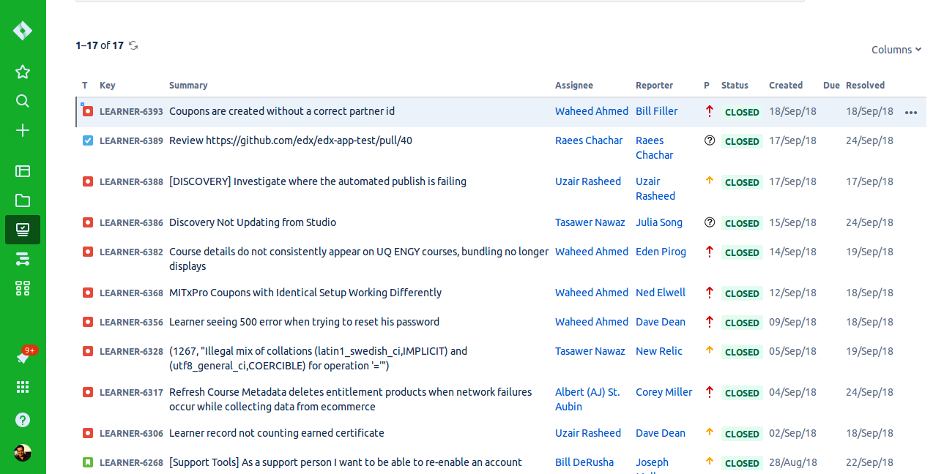

Slide 18
Sprint Retrospective

Slide 19
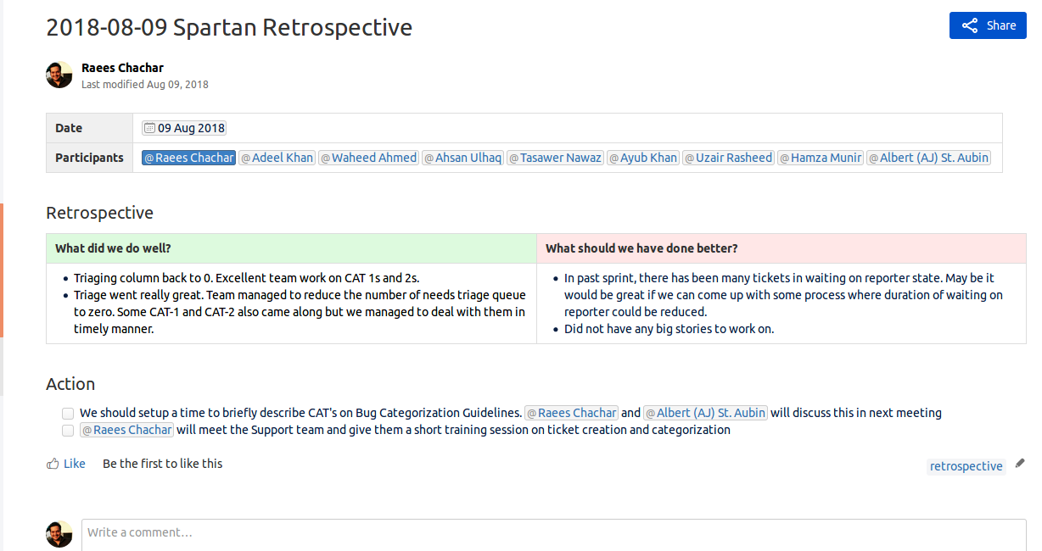

Slide 20
SCRUM Artifacts Scrum describes three primary artifacts: the Product Backlog, the Sprint Backlog, and the Product Increment. Definition of Done

Slide 21
SCRUM VS Waterfall

Slide 22
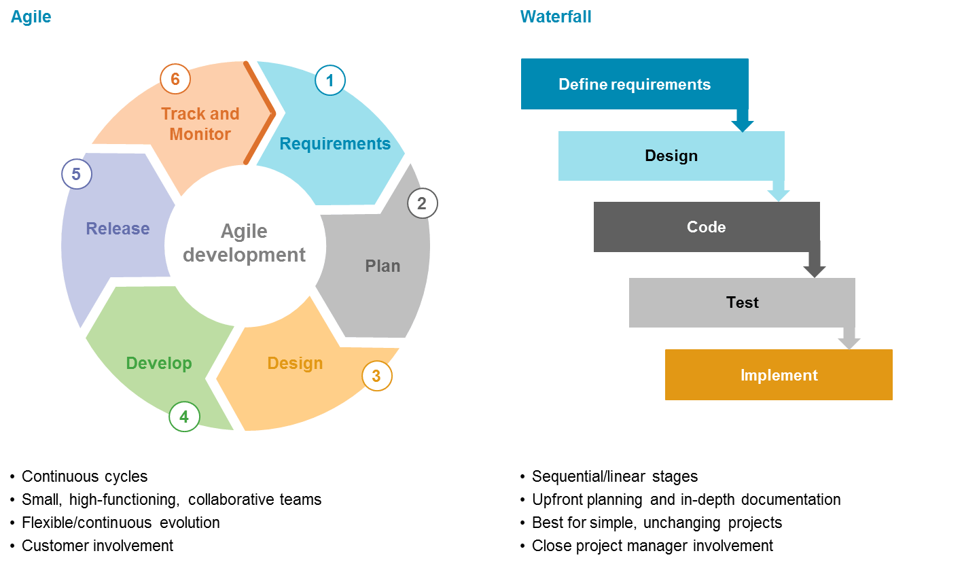

Slide 23
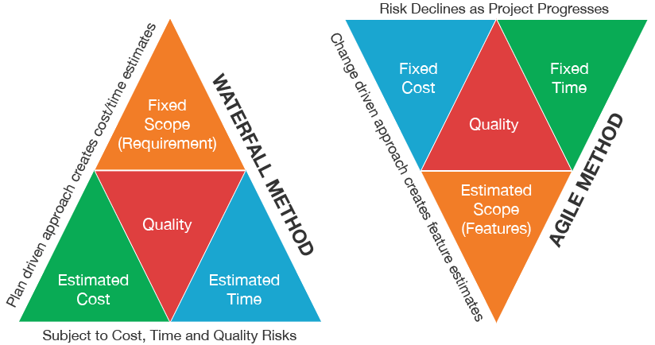

Slide 24
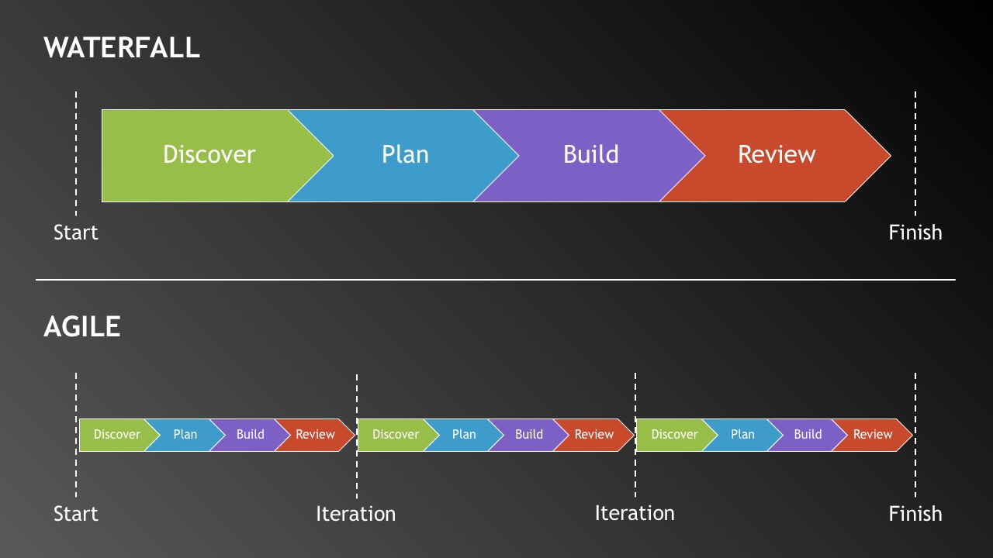

Slide 25
Other Agile Methodologies

Slide 26
Lean Software Development Kanban Extreme Programming (XP) Crystal Dynamic Systems Development Method (DSDM) Feature Driven Development (FDD) TDD CI/CD

Slide 27
Questions?

